Slide 1
The Sorting Problem
Input:
A sequence of n numbers a₁, a₂, . . . , a_{n}
Output:
A permutation (reordering) a₁’, a₂’, . . . , a_{n}’ of the input sequence such that a₁’ ≤ a₂’ ≤ · · · ≤ a_{n}’

Slide 2
Structure of data

Slide 4
Why Study Sorting Algorithms?
There are a variety of situations that we can encounter
Do we have randomly ordered keys?
Are all keys distinct?
How large is the set of keys to be ordered?
Need guaranteed performance?
Various algorithms are better suited to some of these situations

Slide 5
Some Definitions
Internal Sort
The data to be sorted is all stored in the computer’s main memory.
External Sort
Some of the data to be sorted might be stored in some external, slower, device.
In Place Sort
The amount of extra space required to sort the data is constant with the input size.

Slide 6
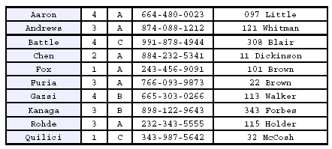
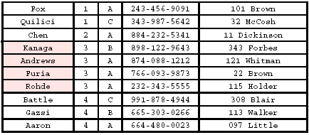
Stability
A STABLE sort preserves relative order of records with equal keys
Sorted on first key:
Sort file on second key:
Records with key value 3 are not in order on first key!!

Slide 7
Insertion Sort
Idea: like sorting a hand of playing cards
Start with an empty left hand and the cards facing down on the table.
Remove one card at a time from the table, and insert it into the correct position in the left hand
compare it with each of the cards already in the hand, from right to left
The cards held in the left hand are sorted
these cards were originally the top cards of the pile on the table

Slide 8
Insertion Sort
To insert 12, we need to make room for it by moving first 36 and then 24.
6
10
24
36
12

Slide 9
Insertion Sort
6
10
24
36
12

Slide 10
Insertion Sort
6
10
24
36
12

Slide 11
Insertion Sort
input array
5 2 4 6 1 3
at each iteration, the array is divided in two sub-arrays:
left sub-array
right sub-array
sorted
unsorted

Slide 12
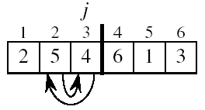
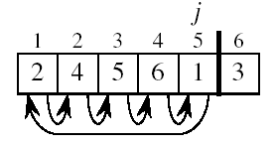
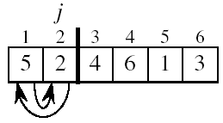
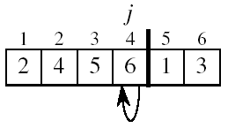
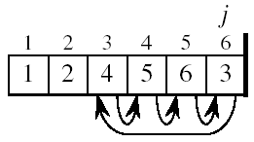
Insertion Sort

Slide 13
INSERTION-SORT
Alg.: INSERTION-SORT(A)
for j ← 2 to n
do key ← A[ j ]
Insert A[ j ] into the sorted sequence A[1 . . j -1]
i ← j - 1
while i > 0 and A[i] > key
do A[i + 1] ← A[i]
i ← i – 1
A[i + 1] ← key
Insertion sort – sorts the elements in place
1
2
3
4
5
6
7
8
a₁
a₂
a₃
a₄
a₅
a₆
a₇
a₈
key

Slide 14
Loop Invariant for Insertion Sort
Alg.: INSERTION-SORT(A)
for j ← 2 to n
do key ← A[ j ]
Insert A[ j ] into the sorted sequence A[1 . . j -1]
i ← j - 1
while i > 0 and A[i] > key
do A[i + 1] ← A[i]
i ← i – 1
A[i + 1] ← key
Invariant: at the start of the for loop the elements in A[1 . . j-1] are in sorted order

Slide 15
Proving Loop Invariants
Proving loop invariants works like induction
Initialization (base case):
It is true prior to the first iteration of the loop
Maintenance (inductive step):
If it is true before an iteration of the loop, it remains true before the next iteration
Termination:
When the loop terminates, the invariant gives us a useful property that helps show that the algorithm is correct
Stop the induction when the loop terminates

Slide 16
Loop Invariant for Insertion Sort
Initialization:
Just before the first iteration, j = 2:
the subarray A[1 . . j-1] = A[1], (the element originally in A[1]) – is sorted

Slide 17
Loop Invariant for Insertion Sort
Maintenance:
the while inner loop moves A[j -1], A[j -2], A[j -3], and so on, by one position to the right until the proper position for key (which has the value that started out in A[j]) is found
At that point, the value of key is placed into this position.

Slide 18

Loop Invariant for Insertion Sort
Termination:
The outer for loop ends when j = n + 1 ⇒ j-1 = n
Replace n with j-1 in the loop invariant:
the subarray A[1 . . n] consists of the elements originally in A[1 . . n], but in sorted order
The entire array is sorted!
j - 1
j
Invariant: at the start of the for loop the elements in A[1 . . j-1] are in sorted order

Slide 19
Analysis of Insertion Sort
INSERTION-SORT(A)
for j ← 2 to n
do key ← A[ j ]
Insert A[ j ] into the sorted sequence A[1 . . j -1]
i ← j - 1
while i > 0 and A[i] > key
do A[i + 1] ← A[i]
i ← i – 1
A[i + 1] ← key
cost times
c₁ n
c₂ n-1
0 n-1
c₄ n-1
c₅
c₆
c₇
c₈ n-1
t_{j}: # of times the while statement is executed at iteration j
Notes:
₇

Slide 20
Best Case Analysis
The array is already sorted
A[i] ≤ key upon the first time the while loop test is run (when i = j -1)
t_{j} = 1
T(n) = c₁n + c₂(n -1) + c₄(n -1) + c₅(n -1) + c₈(n-1) = (c₁ + c₂ + c₄ + c₅ + c₈)n + (c₂ + c₄ + c₅ + c₈)
= an + b = Θ(n)
“while i > 0 and A[i] > key”

Slide 21
Worst Case Analysis
The array is in reverse sorted order
Always A[i] > key in while loop test
Have to compare key with all elements to the left of the j-th position ⇒ compare with j-1 elements ⇒ t_{j} = j
a quadratic function of n
T(n) = Θ(n²) order of growth in n²
“while i > 0 and A[i] > key”
using
we have:

Slide 22
Comparisons and Exchanges in Insertion Sort
INSERTION-SORT(A)
for j ← 2 to n
do key ← A[ j ]
Insert A[ j ] into the sorted sequence A[1 . . j -1]
i ← j - 1
while i > 0 and A[i] > key
do A[i + 1] ← A[i]
i ← i – 1
A[i + 1] ← key
cost times
c₁ n
c₂ n-1
0 n-1
c₄ n-1
c₅
c₆
c₇
c₈ n-1
≈ n²/2 comparisons
≈ n²/2 exchanges

Slide 23
Insertion Sort - Summary
Advantages
Good running time for “almost sorted” arrays Θ(n)
Disadvantages
Θ(n²) running time in worst and average case
≈ n²/2 comparisons and exchanges

Slide 24
Bubble Sort (Ex. 2-2, page 38)
Idea:
Repeatedly pass through the array
Swaps adjacent elements that are out of order
Easier to implement, but slower than Insertion sort
i
1
2
3
n
8
4
6
9
2
3
1
j

Slide 25
Example
8
4
6
9
2
3
1
1
8
4
6
9
2
3
i = 1
j
i = 2
j
8
4
6
9
2
1
3
1
2
8
4
6
9
3
i = 1
j
i = 3
j
8
4
6
9
1
2
3
1
2
3
8
4
6
9
i = 1
j
i = 4
j
8
4
6
1
9
2
3
1
2
3
4
8
6
9
i = 1
j
i = 5
j
8
4
1
6
9
2
3
1
2
3
4
6
8
9
i = 1
j
i = 6
j
8
1
4
6
9
2
3
1
2
3
4
6
8
9
i = 1
j
i = 7
1
8
4
6
9
2
3
j
i = 1
j

Slide 26
Bubble Sort
Alg.: BUBBLESORT(A)
for i ← 1 to length[A]
do for j ← length[A] downto i + 1
do if A[j] < A[j -1]
then exchange A[j] ↔ A[j-1]
i
8
4
6
9
2
3
1
i = 1
j

Slide 27
Bubble-Sort Running Time
Alg.: BUBBLESORT(A)
for i ← 1 to length[A]
do for j ← length[A] downto i + 1
do if A[j] < A[j -1]
then exchange A[j] ↔ A[j-1]
c₁
c₂
Comparisons: ≈ n²/2
c₃
c₄
Exchanges: ≈ n²/2
T(n) =
c₁(n+1) +
c₂
c₃
c₄
= Θ(n) +
(c₂ + c₂ + c₄)
Thus,T(n) = Θ(n²)

Slide 28
Selection Sort (Ex. 2.2-2, page 27)
Idea:
Find the smallest element in the array
Exchange it with the element in the first position
Find the second smallest element and exchange it with the element in the second position
Continue until the array is sorted
Disadvantage:
Running time depends only slightly on the amount of order in the file

Slide 29
Example
8
4
6
9
2
3
1
1
2
3
4
9
6
8
1
4
6
9
2
3
8
1
2
3
4
6
9
8
1
2
6
9
4
3
8
1
2
3
4
6
8
9
1
2
3
9
4
6
8
1
2
3
4
6
8
9

Slide 30
Selection Sort
Alg.: SELECTION-SORT(A)
n ← length[A]
for j ← 1 to n - 1
do smallest ← j
for i ← j + 1 to n
do if A[i] < A[smallest]
then smallest ← i
exchange A[j] ↔ A[smallest]
8
4
6
9
2
3
1

Slide 31
Analysis of Selection Sort
Alg.: SELECTION-SORT(A)
n ← length[A]
for j ← 1 to n - 1
do smallest ← j
for i ← j + 1 to n
do if A[i] < A[smallest]
then smallest ← i
exchange A[j] ↔ A[smallest]
cost times
c₁ 1
c₂ n
c₃ n-1
c₄
c₅
c₆
c₇ n-1
n²/2
comparisons
n
exchanges

